Slide 1
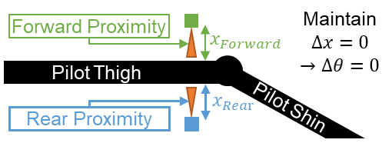
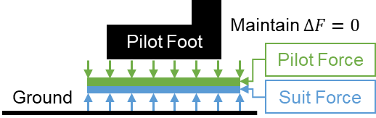
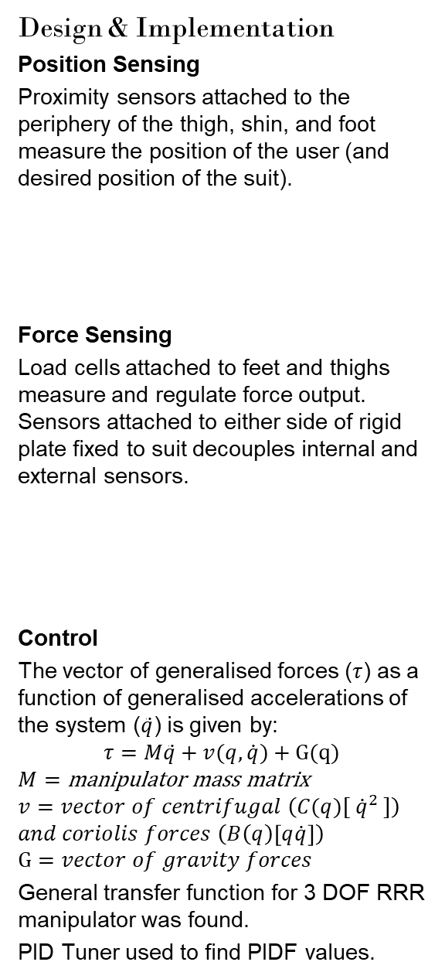
I AM FERROUS MAN
Samuel Williams & Dr Paul Pounds
Goals
Proof of concept for a position based exoskeleton control system.
Exoskeleton: A wearable machine used to augment the pilot’s physicality.
Background
Conventional exoskeletons use force based sensing to perceive the pilot’s desired position. Force based methods can be unstable and physically taxing.
Control can be accomplished by maintaining a constant offset between an exoskeleton and pilot.
Final proof of concept requires:
Stability while static (standing)
Realtime movement (walking)
Regulated force application (sitting)
These actions may be accomplished by measuring and/or controlling the:
position of the pilot and the suit;
force applied by suit and pilot to suit;
actuator position and torque.
Scope
Scope limited to the creation of the perception and control systems of a lower extremity exoskeleton.
Perception systems to measure:
Force output of pilot and suit;
Relative position of pilot to suit; &,
Control systems to determine torque to maintain concentric offset from pilot.
Design & Implementation
Position Sensing
Proximity sensors attached to the periphery of the thigh, shin, and foot measure the position of the user (and desired position of the suit).
Force Sensing
Load cells attached to feet and thighs measure and regulate force output. Sensors attached to either side of rigid plate fixed to suit decouples internal and external sensors.
Control
The vector of generalised forces ($τ$) as a function of generalised accelerations of the system ($\ddot{q}$) is given by:
$$τ=M\ddot{q}+v(q,\dot{q})+G(q)$$
$$M=\text{manipulator} \text{mass} \text{matrix}$$
$$v=vector of centrifugal \left(C(q)[ {\dot{q}}^{2} ]\right)$$
$$and coriolis forces \left(B\left(q\right)\left[q\dot{q}\right]\right)$$
$$G=vector of gravity forces$$
General transfer function for 3 DOF RRR manipulator was found.
PID Tuner used to find PIDF values.
Signal/Data Flow Diagram
Motor interface extends original scope.
Project Achievements
Position Sensors: TRCT5000 IR Transceiver selected and implemented. Firmware written, tested, and commissioned. Signal amplified by LM358AD Op Amp before being read by 12-Bit ADC of NUCLEO-F303K8. Position of pilot relative to the suit, and control error (angle) is measurable.
Force Sensors: Load Cells (YZC-161B) in Wheatstone bridge configuration amplified by INA125PA Instrumentation Amplified calibrated and commissioned. Force applied by pilot to the suit and force applied by the suit to the environment measurable. Control error (force) is measurable with NUCLEO.
Control: Control variables and parameters (PIDF) found using MATLAB PID Tuner for all three leg segments. General equations of motion and transfer functions found for 3 DOF RRR system (e.g. arms and legs).
Communications: Two UART channels per NUCLEO used to connect six daisy chained boards. System may be extended to any number of boards (e.g. full body suit).
Further Works
Controls and perception systems are compete. Design and construction of the actuation and structural systems should be completed. Integrated testing to prove concept should be conducted.
Previous Controller
Next Controller
UART [Baud 9600]
UART [Baud 9600]
RX(PA3), TX(PA2)
RX(PA10), TX(PA9)
UART [Baud 9600]
UART [Baud 9600]
UART1
UART2
Messages [ASCII]
Messages [ASCII]
DMA
Messages [ASCII]
Control & Status
Memory
NUCLEO-F303K8 Controller Software
Messages [ASCII]
Proximity
(P1..P4)
PA4..PA7
Timer 3 Channel 1
Proximity (P1..P4) 0-5V
Control
LM358AD Op Amp x2
PWM Interface
50kHz
Load (Top, Bottom)
Signal (P1..P4) 0-5V
Digital Control
PA0, PA1
PB4
4x Vishay TRCT5000 IR Sensor
Voltage 50kHz
Load (Top, Bottom) 0-5V
Servo
2x INA125PA
Instrumentation Amp
Power 50kHz
Motor
Load (T1..T4, B1..B4)
PXY = GPIO Port X Pin Y
8x YZC-161B
50kg Load Cell

